Slide 1
Member information management system
E/14 CO227 Project
Group 1

Slide 2


TIRED OF WRITING ENTRIES??? TIRED OF MANAGING FILES???

Slide 3

ULTIMATE SOLUTION???
Online database
Computer based
management system

Slide 4
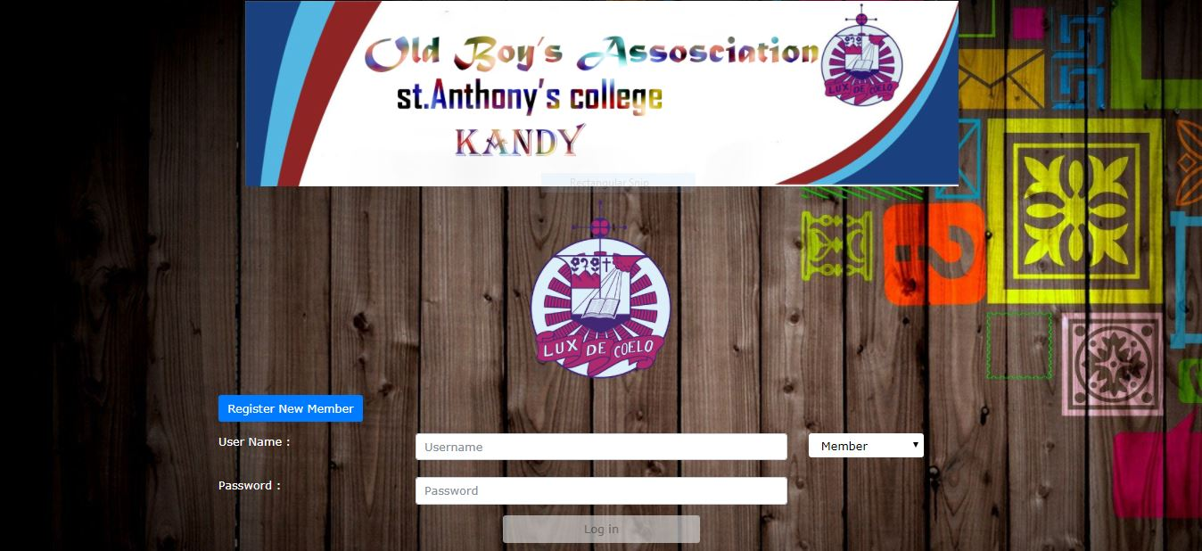
Usage…
Four different access levels
Access anytime anywhere
Member
Registrar
Secretary
Administrator

Slide 5
Benefits…
Ease of access
Security
Minimizing data loss and misplacement
Ability to load from thousands of entries
Allowing an entity to add/remove users
Access anywhere anytime

Slide 6

Simulation

Slide 7

Questions???

